Slide 1

B.Tech. Project Evaluation Load Balancing and Task Execution in Fog-Assisted Networks:
An incentive-based bargaining approach
PRESENTED BY:
Snigdha Kashyap, 2018003781
Saahil Kumar Singh, 2018015052
Abhishek Rouniyar, 2018015598
Rajsi Saxena, 2018005147
UNDER THE SUPERVISION OF:
Mr. Avinash Kumar
(Asst. Professor, Dept. of CSE)
Sharda University,
Gr. Noida
DEPARTMENT OF COMPUTER SCIENCE & ENGINEERING
SCHOOL OF ENGINEERING AND TECHNOLOGY
May, 2022

Slide 2
Table of Contents
Page No
Approval from the guide 3
Project overview 5
Project timeline: Gantt chart 6
Workload distribution 7
Improvement/Work done from the last evaluation 8
Proof of paper communicated & published 9
Conclusion 11

Slide 3
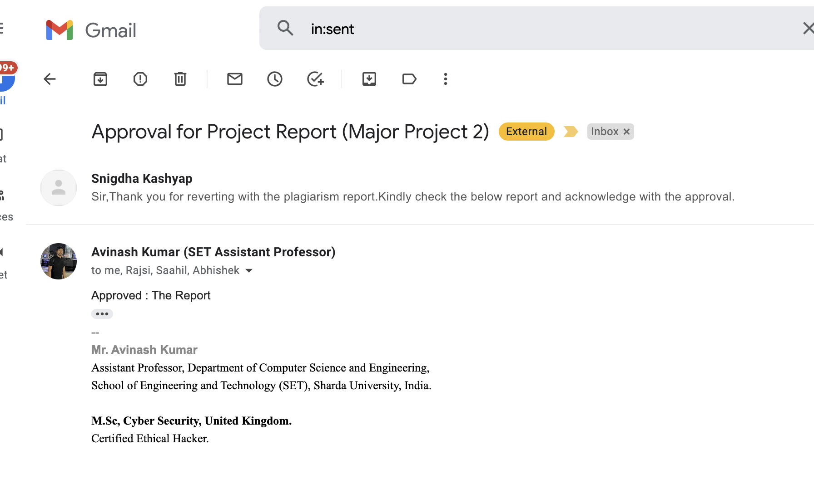
Approval of the guide
Report Approval

Slide 4
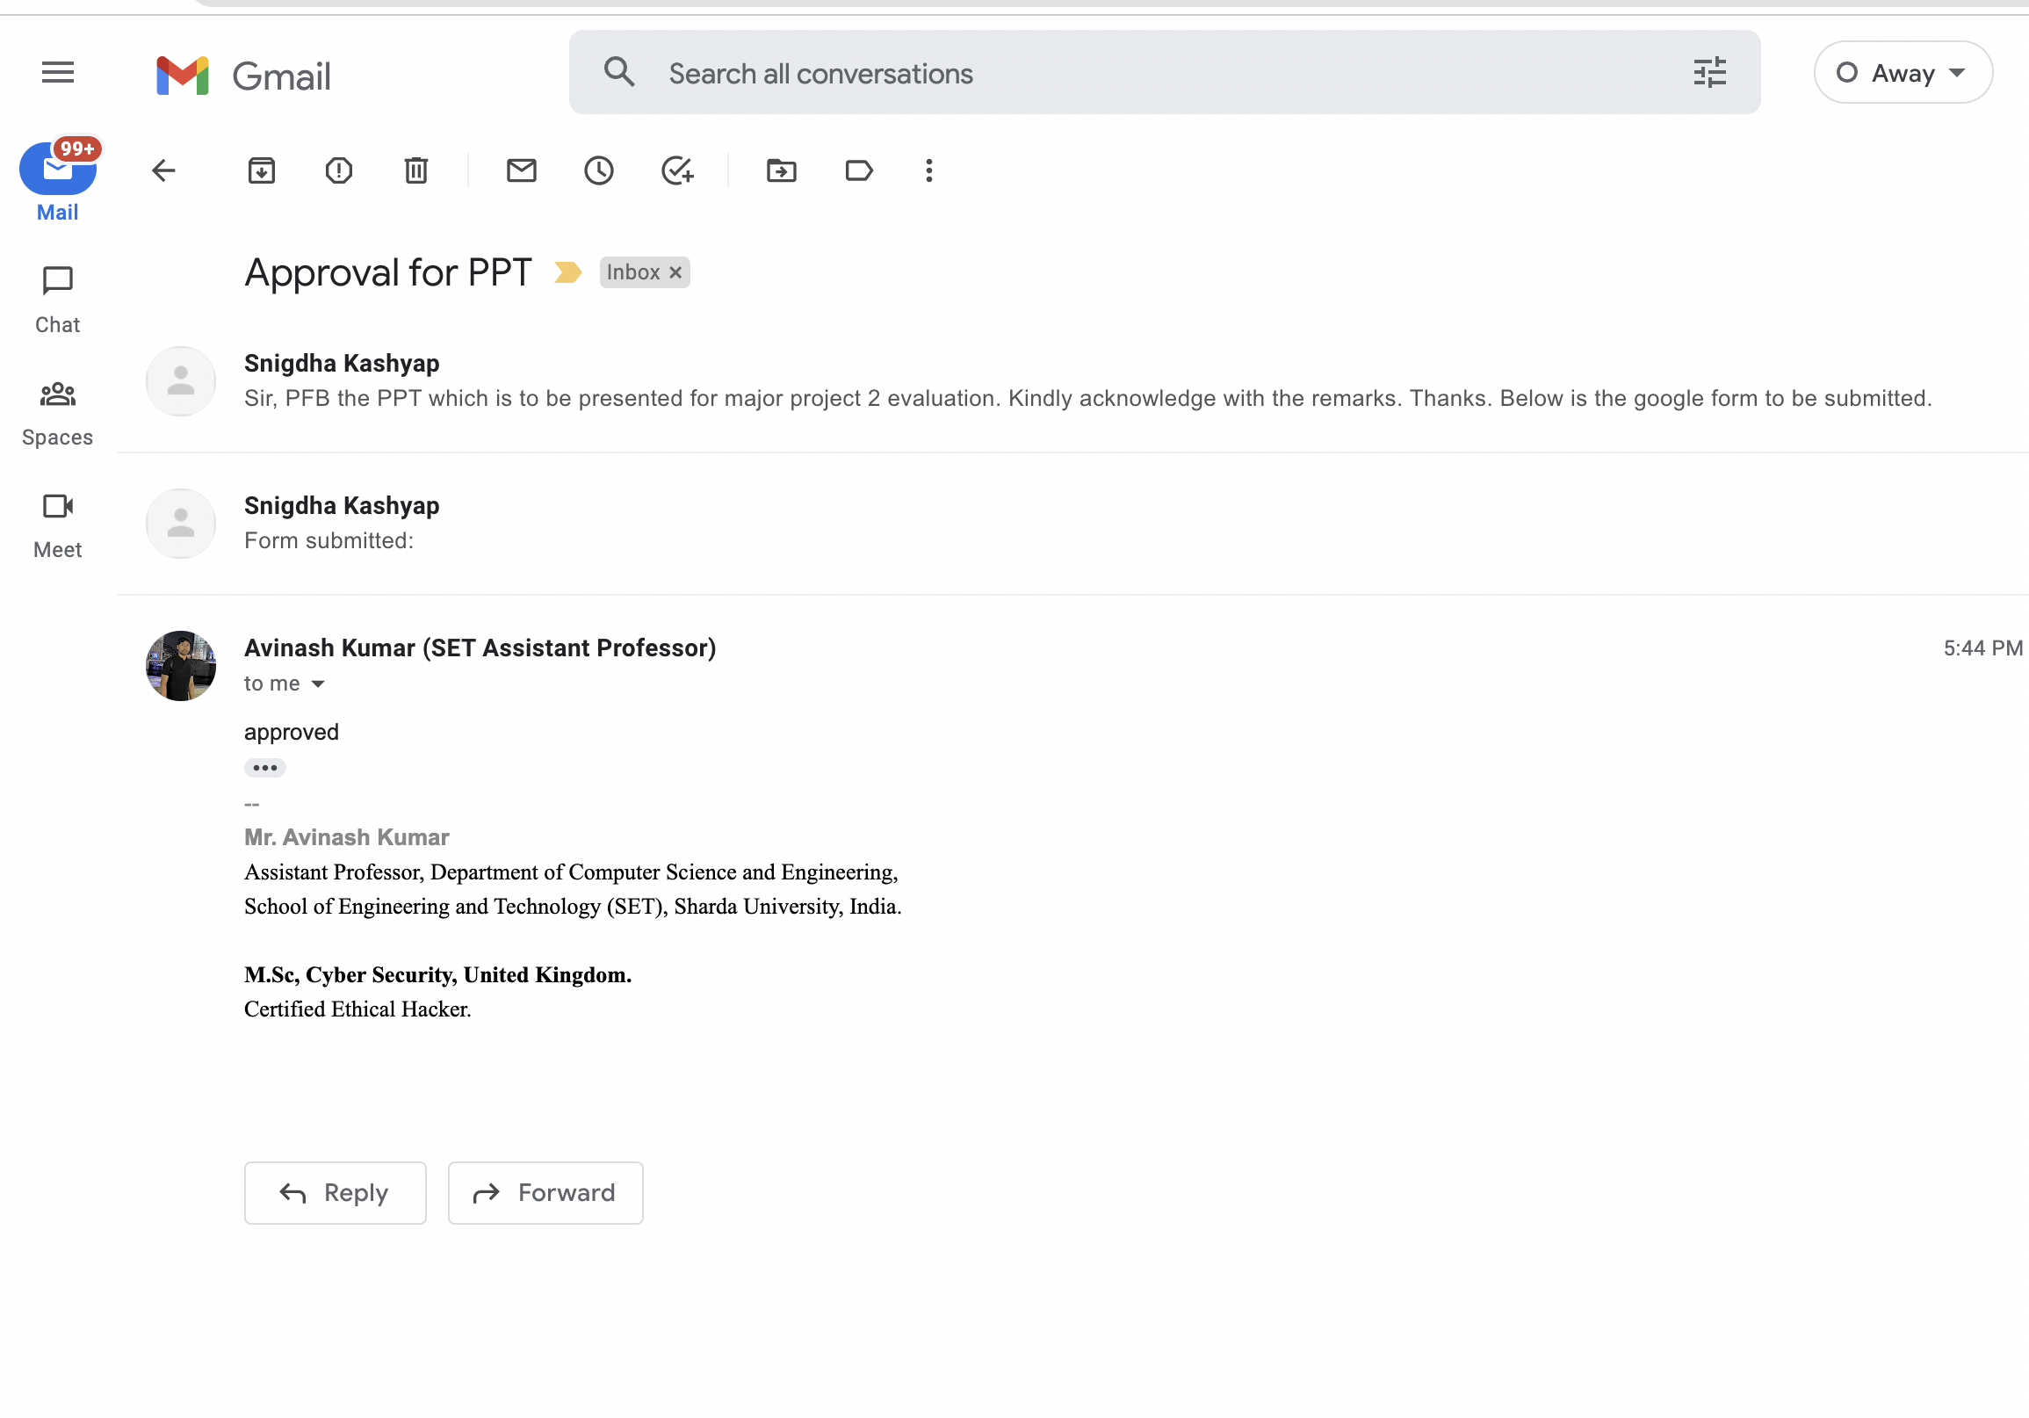
PPT Approval

Slide 5
Project Overview
Project title “Load Balancing and Resource Allocation in Fog-Assisted 5G Networks- A Game theoretic Approach”
Problem statement:
To emphasise load balancing and task execution in Fog-assisted wireless networks.
Discuss Nash Bargaining approach to allow cooperation among fog nodes in network.
Formulate and propose an incentive-based cooperative and cost-effective approach for load balancing.
Simulate the solution and compare with existing systems.

Slide 6
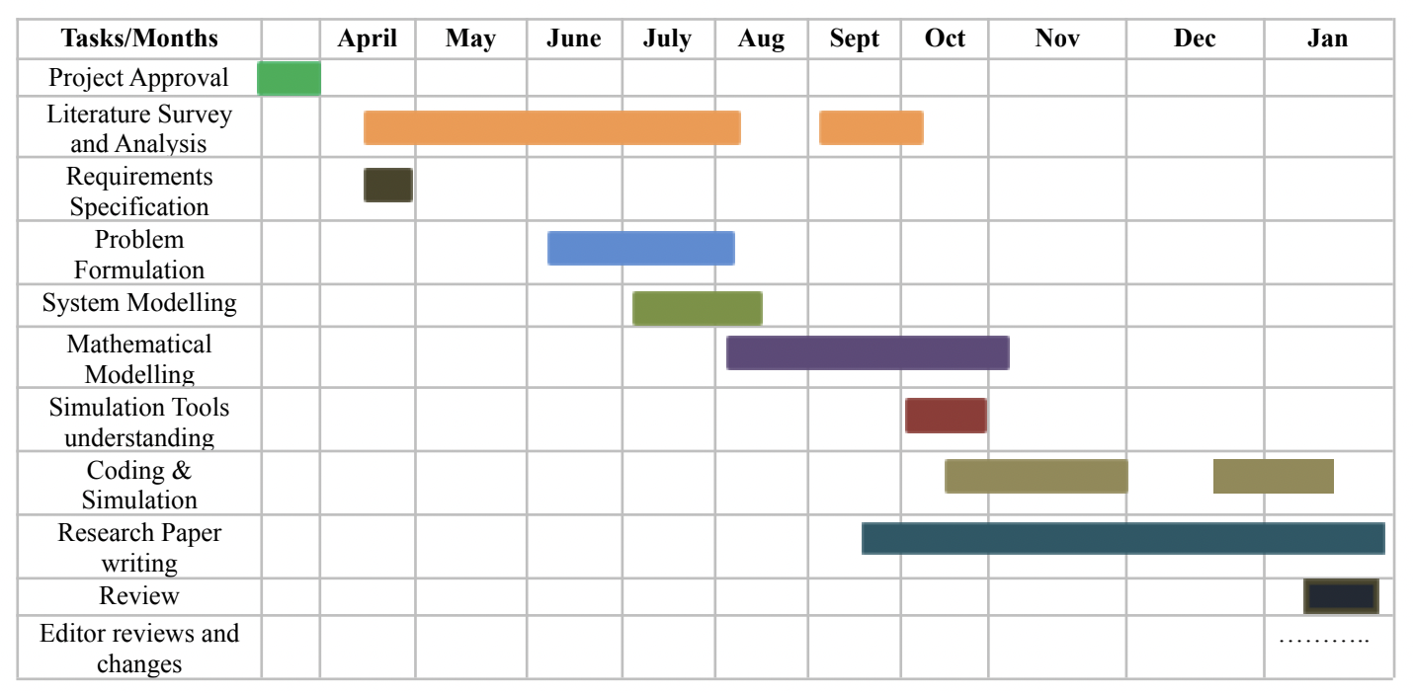
Project timeline: Gantt Chart

Slide 7
Workload distribution
Tasks/Assignee | Abhishek | Saahil | Rajsi | Snigdha
Literature Survey | Y | Y | Y | Y
Problem Formulation | Y | Y | Y | Y
System Modelling; Cost modelling | Y | Y
Mathematical Formulation |  |  | Y | Y
Simulation |  |  |  | Y
Paper Writing, Drafting | Y | Y | Y | Y

Slide 8
Improvements/Work done from last evaluation
Updated the paper submitted in;
Networks and Spatial Economics (Springer)
Submission and successful publishing of survey paper in IJARIIT (Volume 8, Issue 3)
Omitted minor grammatical errors
Added Data availability statement
Added conflict of statement
Submitted updated manuscript for review

Slide 9
Proof of survey paper published
The paper has been submitted and published in IJARIIT journal: Volume 8, Issue 3
Current Status: Paper accepted and Published.
LINK: https://www.ijariit.com/manuscript/game-theory-based-task-offloading-in-fog-based-wireless-networks/

Slide 10
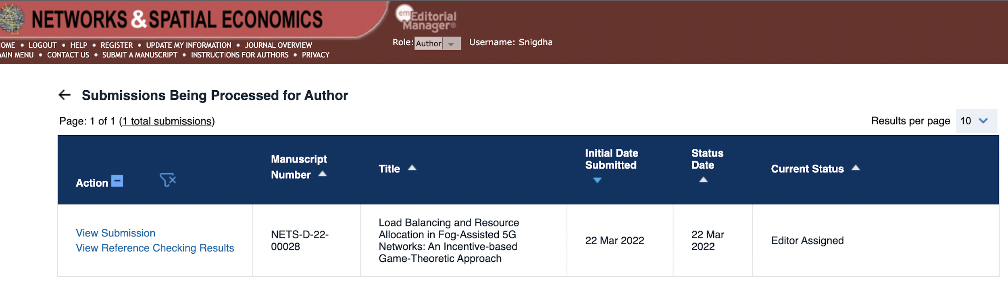
Proof of research paper communicated
The paper has been submitted in Springer journal: Networks and Spatial Economics on 22nd March, 2022
Current Status: Primary changes made, editor assigned to review the content.

Slide 11
Conclusion
We have demonstrated the setting of fog nodes and fog users in a fog-assisted network and formulated a task offloading problem. We devised a cooperative approach in order to model a more efficient and cost-effective task execution and load balancing among fog nodes. We have taken into consideration different costs incurred by the fog nodes and users including delay in transmission, energy cost, incentives. Finally, we simulated the comparison of total cost incurred in case of independent and bargaining task offloading approach and proved the efficiency and cost-effectiveness of bargaining or cooperative incentive-based approach over an independent one.
Research paper and related content: Link

